Slide 1

Start your students on their journey planning for college or career
Slides you can show in class

Slide 2



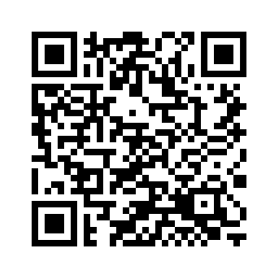
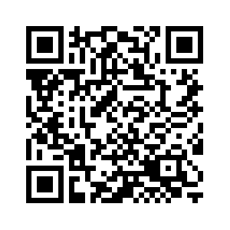
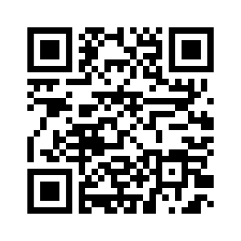
What do you want to do after high school?
It’s ok to not know. It’s getting started that matters. Explore today!
I don’t know where to start!
I don’t know where to go for career training or school!
I don’t know how to pay for it!
Take the career quiz
Take the college quiz
Take the scholarship quiz

