Slide 1

Connect careers to your classroom
Career slides you can show in class

Slide 2

Instructions for Teachers
Ways to use these slides
About BigFuture Career Search
Career information is from O*NET by the U.S. Department of Labor.
It contains over 1,000 career profiles including information on:
Median local and national income
Projected job growth
Average education level
Students can also take a 15-minute career quiz to get matched with up to 30 potential careers to explore on BigFuture.
Take 2 minutes: Show a slide per day as your students are walking into class.
Take 10-15 minutes: Create a gallery walk or career stations for students to view different careers.
Provide individual time: Have students review the Career index slide for careers they’re interested in.
Optional: Have students review and respond to the reflection questions.

Slide 3

About the Slides
There are 5 slides for each of these content areas:
  STEM
  English
  Arts
  History and Social Sciences
  World Languages and Cultures
Each slide highlights one career with information about median yearly income, most common education level, and projected job growth.
Each slide provides a QR code to learn more about the career.
Students can stay organized by adding careers they like to their career list on BigFuture.
Use this resource to connect your students to scholarships:
Juniors and seniors can qualify for monthly $500 and $40,000 scholarship drawings just by adding three careers to their career list on BigFuture.
Share more with students about how to automatically earn scholarship entries at bigfuture.org/scholarships

Slide 4
Career Index
Skip to the career(s) that interests you most:
Careers Related to STEM Courses
  Automotive Engineering Technician
  Food Science Technician
  Human Factors Engineers and Ergonomists
  Conservation Scientist
  Cartographers and Photogrammetrists
Careers Related to English Courses
  Advertising and Promotions Manager
  Public Relations Specialists
  Speech-Language Pathologists
  Court Reporters and Simultaneous Captioners
  Fundraisers
Careers Related to Arts Courses
  Lighting Technicians
  Agents and Business Managers
  Architects
  Art Directors
  Commercial and Industrial Designers
Careers Related to History and Social Sciences Courses
  Equal Opportunity Representatives and Officers
  Industrial-Organizational Psychologist
  Paralegal and Legal Assistant
  Court and Municipal Clerk
  Political Scientist
Careers Related to World Languages and Cultures Courses
  Travel Agent
  Interpreters and Translators
  Anthropologists and Archaeologists
  Postsecondary Area, Ethnic, and Cultural Studies Teachers
  Transportation Attendant

Slide 5
Careers related to STEM courses

Slide 6
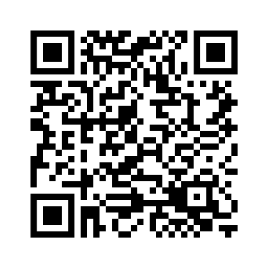
Career of the Day:
Automotive Engineering Technician
Median Yearly Income
What do they do?
Scan for more info about this career
Assist engineers in determining the practicality of proposed product design changes and plan and carry out tests on experimental test devices or equipment for performance, durability, or efficiency.
$60,298
Most Common Education Level
Associate degree
Find more potential careers at
bigfuture.org/career-search

Slide 7
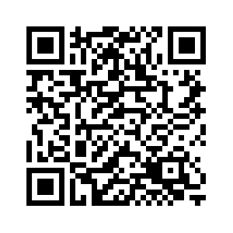
Career of the Day:
Food Science Technician
Median Yearly Income
What do they do?
Scan for more info about this career
Work with food scientists or technologists to perform research and develop production technology, quality control, packaging, processing, and use of foods.
$46,255
Most Common Education Level
High school diploma or less
Find more potential careers at
bigfuture.org/career-search

Slide 8
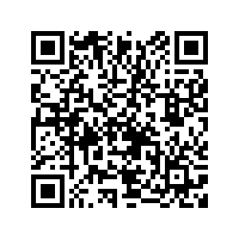
Career of the Day:
Human Factors Engineers and Ergonomists
Median Yearly Income
What do they do?
Scan for more info about this career
Design objects, facilities, and environments to optimize human well-being and overall system performance, applying theory, principles, and data regarding the relationship between humans and respective technology.
$95,169
Most Common Education Level
Master’s or professional degree
Find more potential careers at
bigfuture.org/career-search

Slide 9
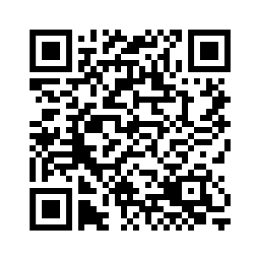
Career of the Day:
Conservation Scientist
Median Yearly Income
What do they do?
Scan for more info about this career
Manage, improve, and protect natural resources to maximize their use without damaging the environment. May conduct soil surveys and develop plans to eliminate soil erosion or to protect rangelands. May instruct farmers, agricultural production managers, or ranchers
$62,540
Most Common Education Level
Bachelor’s degree
Find more potential careers at
bigfuture.org/career-search

Slide 10
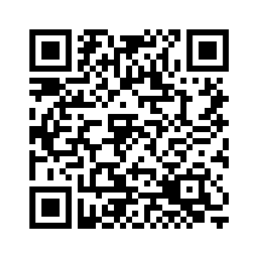
Career of the Day:
Cartographers and Photogrammetrists
Median Yearly Income
What do they do?
Scan for more info about this career
Research, study, and prepare maps and other spatial data in digital or graphic form for one or more purposes, such as legal, social, political, educational, and design purposes.
$68,958
Most Common Education Level
Certificate
Find more potential careers at
bigfuture.org/career-search

Slide 11
Careers related to English courses

Slide 12
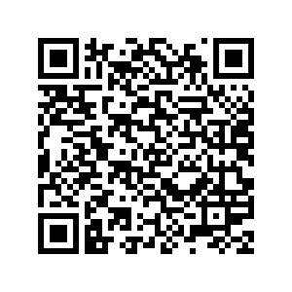
Career of the Day:
Advertising and Promotions Managers
Median Yearly Income
What do they do?
Scan for more info about this career
Plan, direct, or coordinate advertising policies and programs or produce collateral materials, such as posters, contests, coupons, or giveaways, to create extra interest in the purchase of a product or service for a department, an organization, or on an account basis.
$117,295
Most Common Education Level
Bachelor’s degree
Find more potential careers at
bigfuture.org/career-search

Slide 13
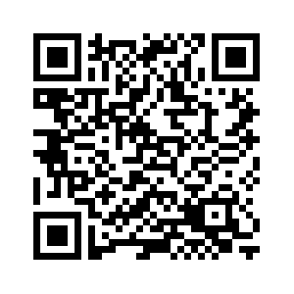
Career of the Day:
Public Relations Specialists
Median Yearly Income
What do they do?
Scan for more info about this career
Promote or create an intended public image for individuals, groups, or organizations. May write or select material for release to various communications media. May specialize in using social media.
$62,987
Most Common Education Level
Bachelor’s degree
Find more potential careers at
bigfuture.org/career-search

Slide 14
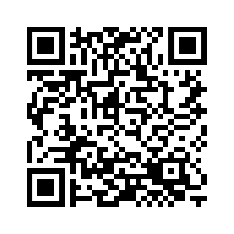
Career of the Day:
Speech-Language Pathologist
Median Yearly Income
What do they do?
Scan for more info about this career
Assess and treat persons with speech, language, voice, and fluency disorders. May select alternative communication systems and teach their use. May perform research related to speech and language problems.
$78,930
Most Common Education Level
Master’s or professional degree
Find more potential careers at
bigfuture.org/career-search

Slide 15
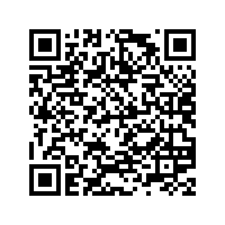
Career of the Day:
Court Reporters and Simultaneous Captioners
Median Yearly Income
What do they do?
Scan for more info about this career
Use verbatim methods and equipment to capture, store, retrieve, and transcribe pretrial and trial proceedings or other information. Includes stenocaptioners who operate computerized stenographic captioning equipment to provide captions of live or prerecorded broadcasts for hearing-impaired viewers.
$60,957
Most Common Education Level
Certificate
Find more potential careers at
bigfuture.org/career-search

Slide 16
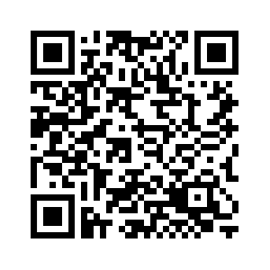
Career of the Day:
Fundraisers
Median Yearly Income
What do they do?
Scan for more info about this career
Organize activities to raise funds or otherwise solicit and gather monetary donations or other gifts for an organization. May design and produce promotional materials. May also raise awareness of the organization's work, goals, and financial needs.
$60,725
Most Common Education Level
Bachelor’s degree
Find more potential careers at
bigfuture.org/career-search

Slide 17
Careers related to Arts courses

Slide 18
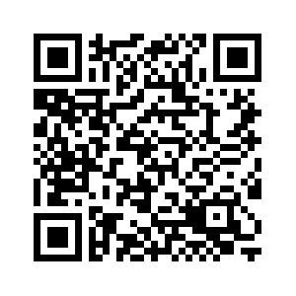
Career of the Day:
Lighting Technicians
Median Yearly Income
What do they do?
Scan for more info about this career
Set up, maintain, and dismantle light fixtures, lighting control devices, and the associated lighting electrical and rigging equipment used for photography, television, film, video, and live productions. May focus or operate light fixtures, or attach color filters or other lighting accessories.
$51,095
Most Common Education Level
Bachelor’s degree
Find more potential careers at
bigfuture.org/career-search

Slide 19
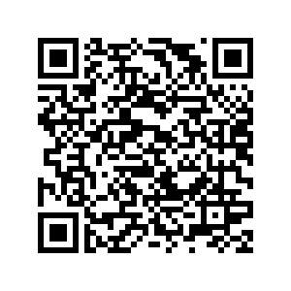
Career of the Day:
Agents and Business Managers
Median Yearly Income
What do they do?
Scan for more info about this career
Represent and promote artists, performers, and athletes in dealings with current or prospective employers. May handle contract negotiation and other business matters for clients.
$68,671
Most Common Education Level
Bachelor’s degree
Find more potential careers at
bigfuture.org/career-search

Slide 20
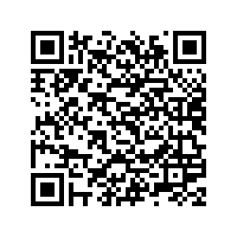
Career of the Day:
Architects
Median Yearly Income
What do they do?
Scan for more info about this career
Plan and design structures, such as private residences, office buildings, theaters, factories, and other structural property.
$77,483
Most Common Education Level
Bachelor’s degree
Find more potential careers at
bigfuture.org/career-search

Slide 21
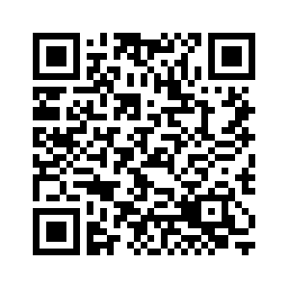
Career of the Day:
Art Directors
Median Yearly Income
What do they do?
Scan for more info about this career
Formulate design concepts and presentation approaches for visual productions and media, such as print, broadcasting, video, and film. Direct workers engaged in artwork or layout design.
$67,900
Most Common Education Level
Bachelor’s degree
Find more potential careers at
bigfuture.org/career-search

Slide 22
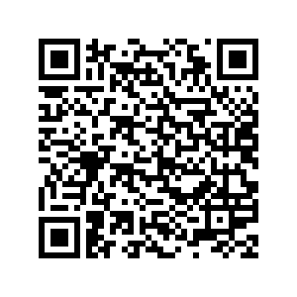
Career of the Day:
Commercial and Industrial Designers
Median Yearly Income
What do they do?
Scan for more info about this career
Design and develop manufactured products, such as cars, home appliances, and children's toys. Combine artistic talent with research on product use, marketing, and materials to create the most functional and appealing product design.
$74,237
Most Common Education Level
Bachelor’s degree
Find more potential careers at
bigfuture.org/career-search

Slide 23
Careers related to History and Social Sciences courses

Slide 24
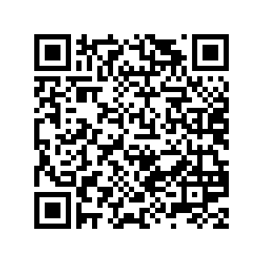
Career of the Day:
Equal Opportunity Representatives and Officers
Median Yearly Income
What do they do?
Scan for more info about this career
Monitor and evaluate compliance with equal opportunity laws, guidelines, and policies to ensure that employment practices and contracting arrangements give equal opportunity without regard to race, religion, color, national origin, sex, age, or disability.
$71,571
Most Common Education Level
Bachelor’s degree
Find more potential careers at
bigfuture.org/career-search

Slide 25
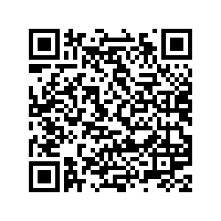
Career of the Day:
Industrial-Organizational Psychologist
Median Yearly Income
What do they do?
Scan for more info about this career
Apply principles of psychology to human resources, administration, management, sales, and marketing problems.
$108,373
Most Common Education Level
Doctoral degree or more
Find more potential careers at
bigfuture.org/career-search

Slide 26
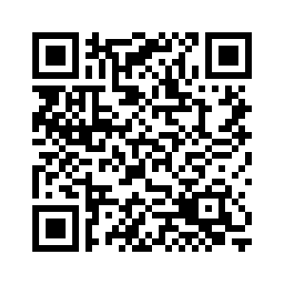
Career of the Day:
Paralegal and Legal Assistant
Median Yearly Income
What do they do?
Scan for more info about this career
Assist lawyers by investigating facts, preparing legal documents, or researching legal precedent. Conduct research to support a legal proceeding, to formulate a defense, or to initiate legal action.
$55,771
Most Common Education Level
Associate degree
Find more potential careers at
bigfuture.org/career-search

Slide 27
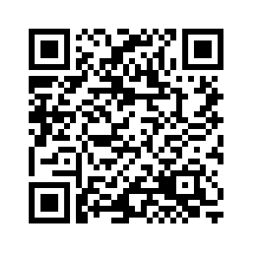
Career of the Day:
Court and Municipal Clerk
Median Yearly Income
What do they do?
Scan for more info about this career
Perform clerical duties for courts of law, municipalities, or governmental licensing agencies and bureaus.
$44,651
Most Common Education Level
High school diploma or less
Find more potential careers at
bigfuture.org/career-search

Slide 28
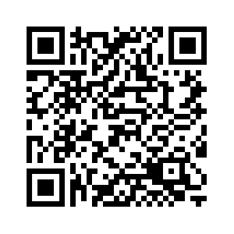
Career of the Day:
Political Scientist
Median Yearly Income
What do they do?
Scan for more info about this career
Study the origin, development, and operation of political systems.
$121,373
Most Common Education Level
Doctoral degree or more
Find more potential careers at
bigfuture.org/career-search

Slide 29
Careers related to World Languages and Cultures courses

Slide 30
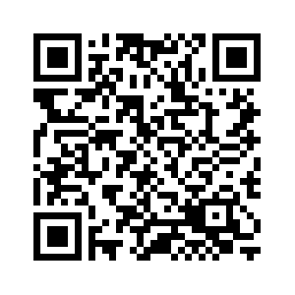
Career of the Day:
Travel Agent
Median Yearly Income
What do they do?
Scan for more info about this career
Plan and sell transportation and accommodations for customers. Determine destination, modes of transportation, travel dates, costs, and accommodations required.
$42,259
Most Common Education Level
Associate degree
Find more potential careers at
bigfuture.org/career-search

Slide 31
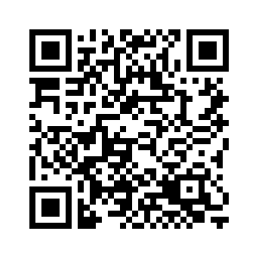
Career of the Day:
Interpreters and Translators
Median Yearly Income
What do they do?
Scan for more info about this career
Interpret oral or sign language, or translate written text from one language into another.
$50,618
Most Common Education Level
Bachelor’s degree
Find more potential careers at
bigfuture.org/career-search

Slide 32
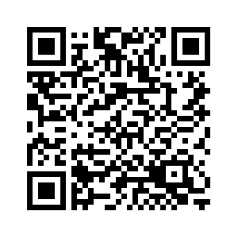
Career of the Day:
Anthropologists and Archaeologists
Median Yearly Income
What do they do?
Scan for more info about this career
Study the origin, development, and behavior of human beings. May study the way of life, language, or physical characteristics of people in various parts of the world. May engage in systematic recovery and examination of material evidence of earlier civilizations.
$59,604
Most Common Education Level
Master’s or professional degree
Find more potential careers at
bigfuture.org/career-search

Slide 33
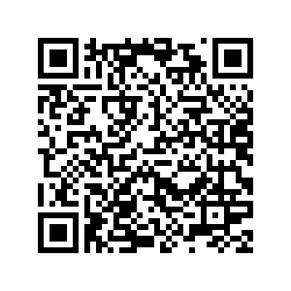
Career of the Day:
Postsecondary Area, Ethnic, and Cultural Studies Teacher
Median Yearly Income
What do they do?
Scan for more info about this career
Teach courses pertaining to the culture and development of an area, an ethnic group, or any other group, such as Latin American studies, women's studies, or urban affairs. Includes both teachers primarily engaged in teaching and those who do a combination of teaching and research.
$79,148
Most Common Education Level
Doctoral degree or more
Find more potential careers at
bigfuture.org/career-search

Slide 34
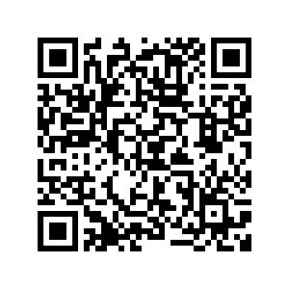
Career of the Day:
Transportation Attendant
Median Yearly Income
What do they do?
Scan for more info about this career
Provide services to ensure the safety of passengers aboard ships, buses, trains, or within the station or terminal. Perform duties such as explaining the use of safety equipment, serving meals or beverages, or answering questions related to travel.
$30,472
Most Common Education Level
High school diploma or less
Find more potential careers at
bigfuture.org/career-search

